Slide 1
2025 Diocesan Services appeal
Diocese of Palm Beach

Slide 2
Hope does not disappoint
^{La Esperanza Do DeFrauda}
^{Lespwa Pa Desevwa}

Slide 3
My Sisters and Brothers in Christ,
Blessings to you in this new year! As we begin the calendar year of 2025, we also begin our annual Diocesan Services Appeal. It is my pleasure to share that this year’s DSA theme is Romans 5:5, “Hope does not disappoint.” This theme dovetails nicely with the 2025 Jubilee Year,
also known as the Year of Hope. Announced by Pope Francis, the Jubilee Year is intended to be a time of hope for the world, as well as a time to
re-establish relationships with God, others and creation. As a diocese, we continue to care for one another in faith, hope and love, while embracing this theme.
Your support of the DSA, through prayer and financial assistance, allows our offices and ministries to fulfill the diocese’s mission and embrace the promise of hope we are given each day. By supporting the DSA, you will help make a definite difference in the lives of your neighbors, for which I would be deeply grateful. Your generosity will sustain our tradition of sharing and bringing hope to others. I prayerfully ask you again to consider a gift to this year’s Diocesan Services Appeal. Please know that I am praying for God’s blessings on you and your family and that you have a renewed sense of hope this year.
With every prayerful wish, I am
^{Sincerely yours in Christ,}
Most Reverend Gerald M. Barbarito
^{Bishop of Palm Beach}

Slide 4
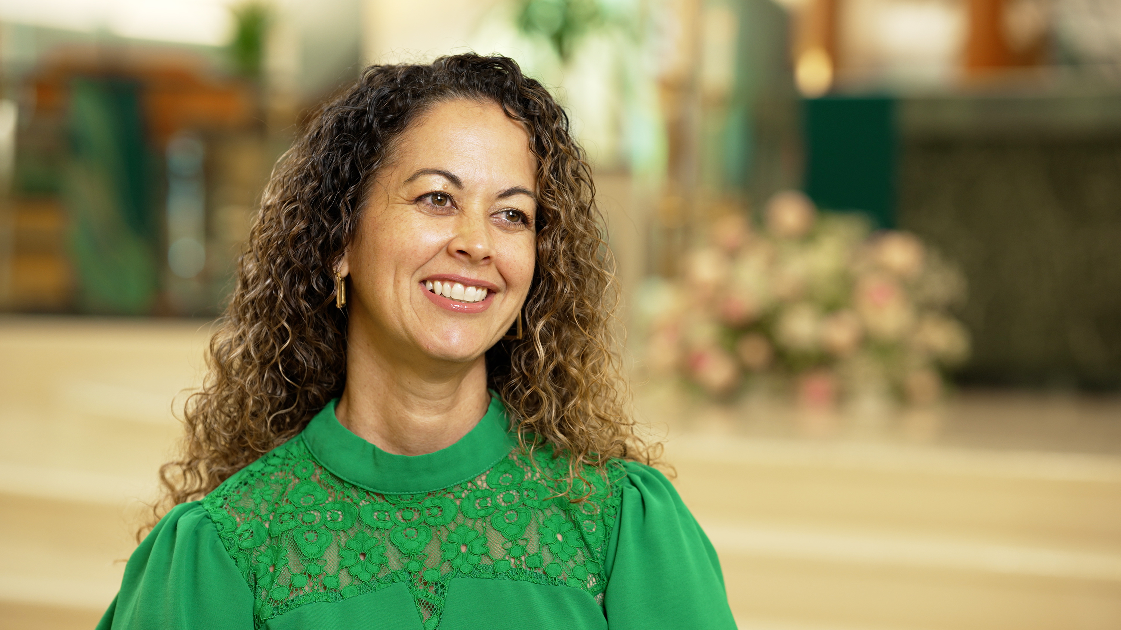
“I get to see first-hand as a DRE how lives are changed within our parish every day, thanks to the DSA. I have witnessed children of every age shine the light of Christ in initiatives like the Catechesis of the Good Shepherd and our new youth ministry. This would not be possible without the support and training I received through the diocese. With the support of the DSA, we have the tools to help our young people develop an unshakable faith foundation and grow in their relationships with the Lord.”
– Bibi, Director of Religious Education
^{St. Clare Catholic Church}

Slide 5
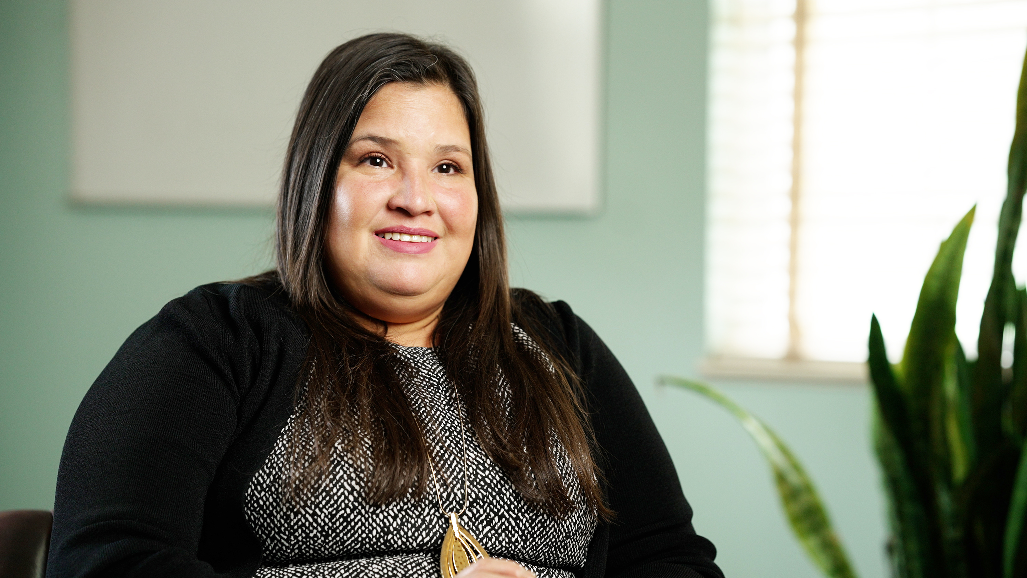
“My son and I were homeless, living in our car,
and desperately seeking help. Despite numerous calls to various shelters, we were repeatedly turned away until we finally reached out to the Samaritan Center, and they said they had a spot for us. When people contribute to the DSA, they’re making investments in safe spaces, warm meals, and secure beds for children. It’s through that kindness and generosity that my son and I have found renewed hope and a glimpse of a brighter future.”
– Jully, a resident of the Catholic Charities Samaritan Center in Vero Beach

Slide 6
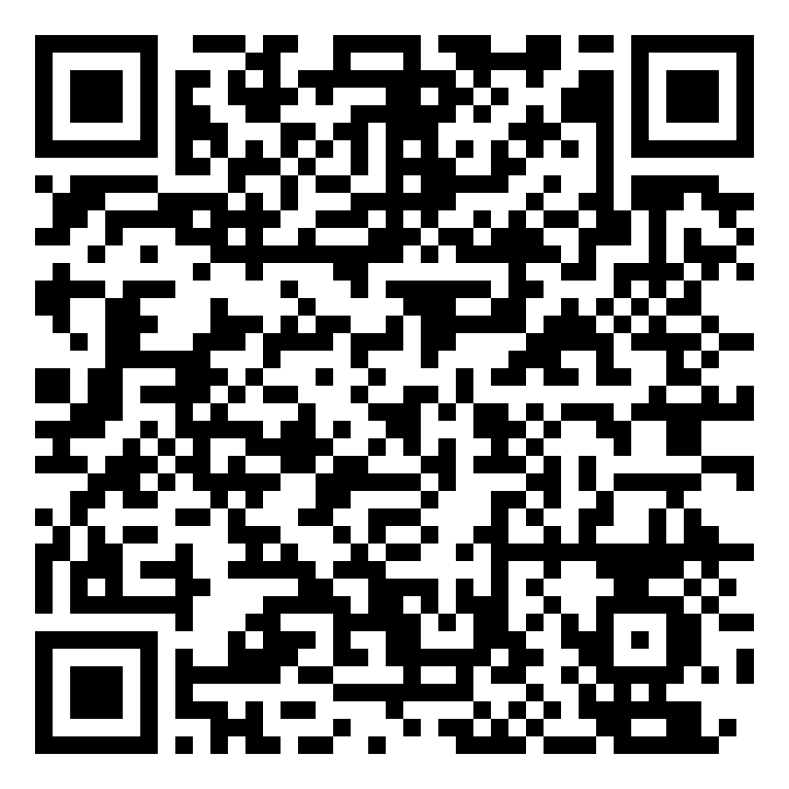
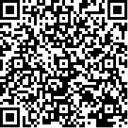
Ways to Give
Donation envelope mailed to your home • In-pew envelope
Planned giving • Online at DiocesePB.org/DSA • Employer gift matching
Gifts and pledges can be made using cash, check, credit card, debit card, direct debit/bank authorization, money order/cashier’s check, stock/securities, endowments, individual retirement account, will/bequests, charitable gift annuity, life insurance
^{View Videos}
^{Give Today}
(561) 775-9590 | DiocesePB.org/DSA

